Slide 1

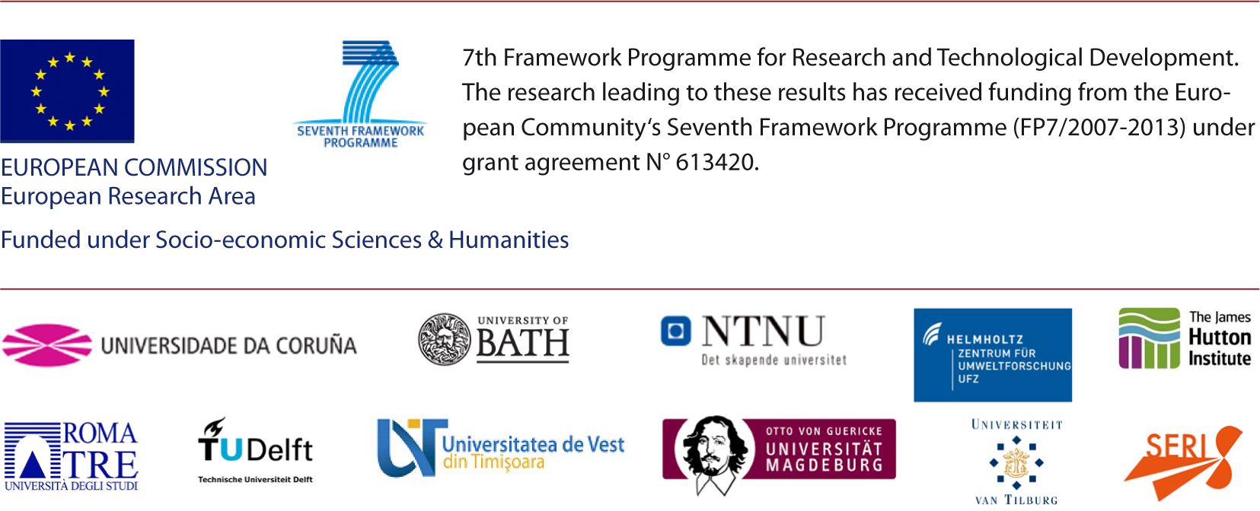
Transforming work: work life balance, mobility and housing
Facilitator: Adina Dumitru (UDC)
Presenter: Tony Craig, The James Hutton Institute
Stakeholder: Klaus Diendorfer (Danube-Bohemian Forest, Austria)
Harvester: Ellen Matthies (OVGU)

Slide 2
Overview of the session
15:30 Welcome (Adina Dumitru)
15:35 A few GLAMURS results (Tony Craig)
15:45 Intervention by Mr. Klaus Diendorfer (Danube-Bohemian Forest, Austria)
15:55 Discussion
16:20 Closure

Slide 3
Transforming work: work life balance, mobility and housing
Presenter: Tony Craig, The James Hutton Institute

Slide 4

Work-life balance and time-pressure
Sleep 8 hours/night
Exercise for an hour/day
Cook healthy meals and eat them
Spend time with family
Write that paper….
Prepare powerpoint presentation…
Reply to 100 emails
Write report by deadline….
Etc…
So much to do…
So little time….

Slide 5
Temporal autonomy and flexible working
….The capacity to choose how to spend one’s time
(a sub-category of general autonomy)
“If your concern is with maximizing people’s temporal autonomy, then one of the most important things policy-makers must do is to ensure work-time flexibility”
(Goodin et al., 2008, p. 267)
I want more control over when I have to do things
Goodin, R. E., Rice, J. M., Parpo, A., & Eriksson, L. (2008). Discretionary time : a new measure of freedom. Cambridge: Cambridge University Press.

Slide 6
Temporal autonomy and flexible working
Growth in flexible work policies in organisations
Can help organisations to reduce energy footprint of building stock, and also commuting-miles.
(Theoretically) can enhance ‘temporal autonomy’
Both temporal and spatial components are important
I want more control over when I have to do things

Slide 7
Temporal autonomy and flexible working
Not everyone can be flexible.
Hot-desking can be problematic
  Storage of ‘stuff’
  Logging into phone, etc..
  Finding people….
  Variable quality of office provision
Health
  “We carry everything with us, we are like snails…..”
  Hygiene: sharing phones, keyboard, mice, etc..
Encouraging home working
  Requires more energy use at home
  Can encourage people to live further away from workplace.
  Reduces social connection

Slide 8
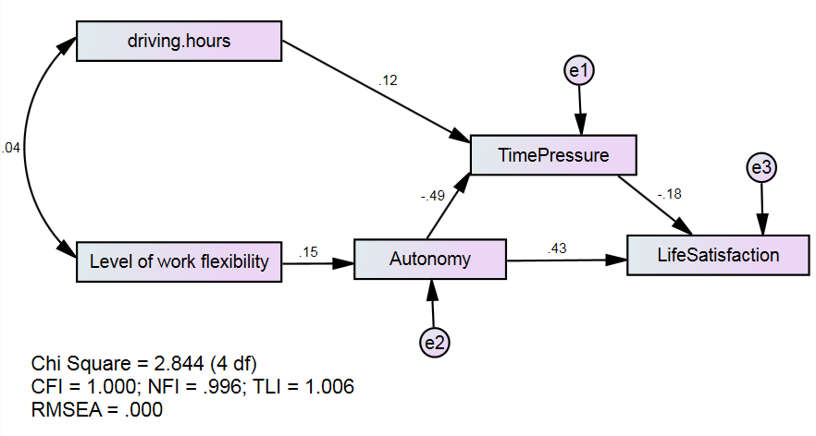
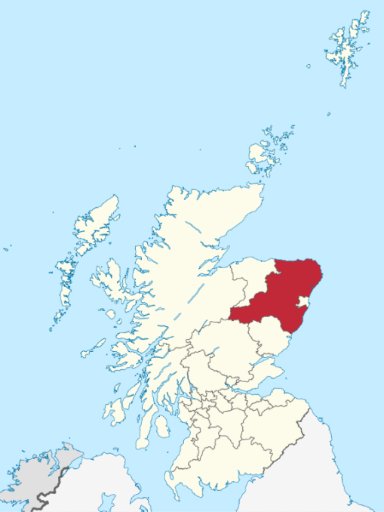
Temporal autonomy and flexible working
Scottish case study survey

Slide 9
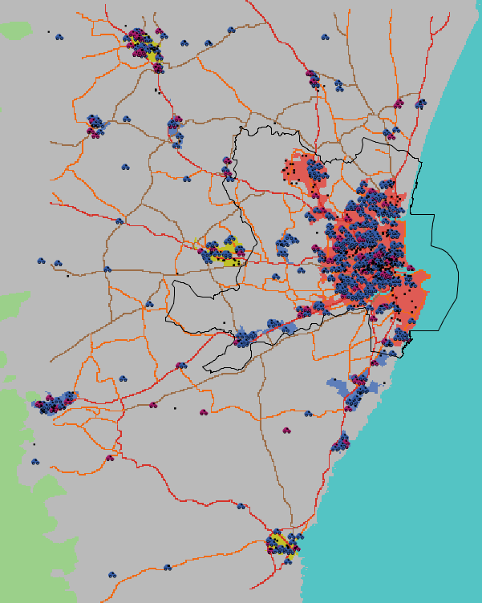
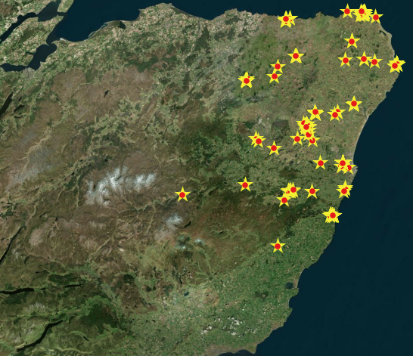
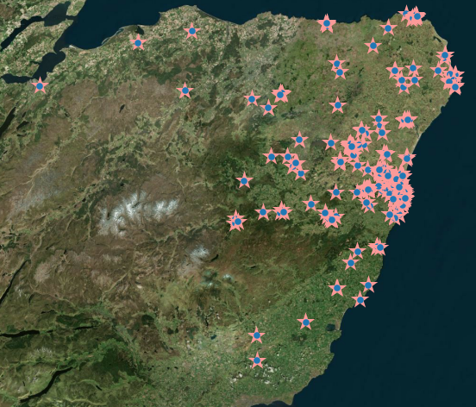
Different scenarios of flexibility….
Data on home and work locations of Aberdeen employees
  Council (magenta car); Other (blue car)
Four share modes:
  Work at a fixed location
  Flexibility for council staff to work in any council office
  Flexibility for council staff to work in other organisations
  Full flexibility for cross-organisational space sharing.
Organizational structure:
  Work in team?
  Democratic / Hierarchical
Workplaces from Aberdeenshire Council sample (left) and Regional sample (right)

Slide 10
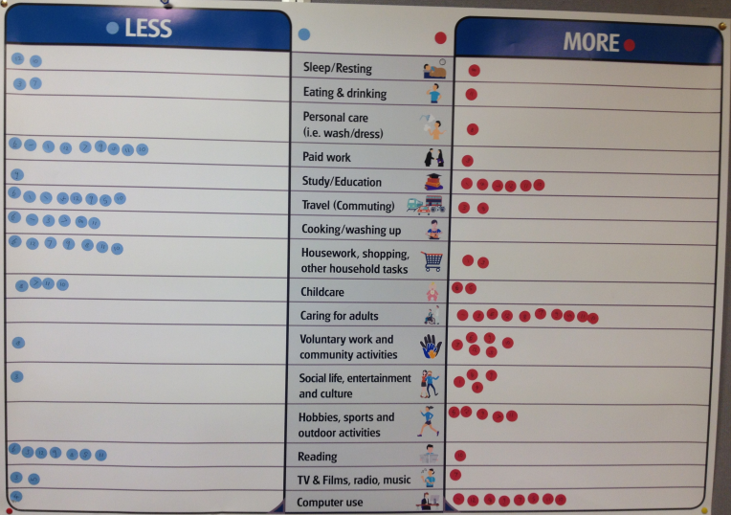
Some final questions….
What level of work flexibility is good:
  For organisations?
  For people?
  For society?
What are the potential implications of flexible working policies on the housing stock?
Can flexible working free-up time to for sustainable lifestyles?
What will ‘work’ look like in the future?

Slide 11
Transforming work: work life balance, mobility and housing
Stakeholder: Mr. Klaus Diendorfer
Danube-Bohemian Forest, LEADER Bureau

Slide 12
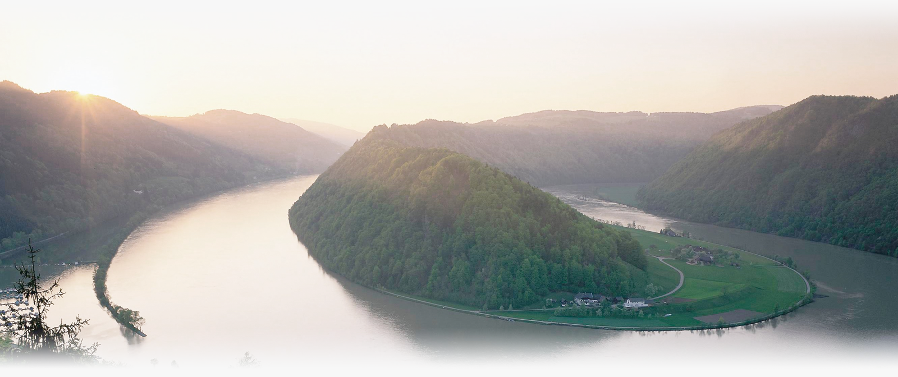
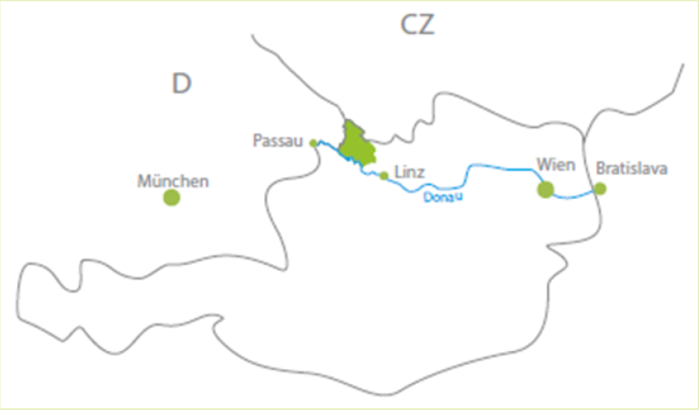

Danube-Bohemian forests: Status quo…
Notes:
rural area located between the Danube and Bohemian forests (Austria, Czech Republic and Germany)
pioniers in organic farming already in early 80-ies
„tradition/history“ of autonomous regional development in Austria (80-ies)
highly diversified economy, small-medium sized enterprises
5.000 enterprises
22.000 employees
3.000 farms (full-time/part-time)
low-unemployrate (4-5%)
BUT
increase of out-commutants since 2001 (+13% public transport; +4% car)
out-migration leads to decrease of population in northern municipalities (-5-10% till 2030)
individual mobility versus less people/time for volunteer/community work
(Local Development Strategy Danube-Bohemian Forests for 2014-2020; June 2015)

Slide 13

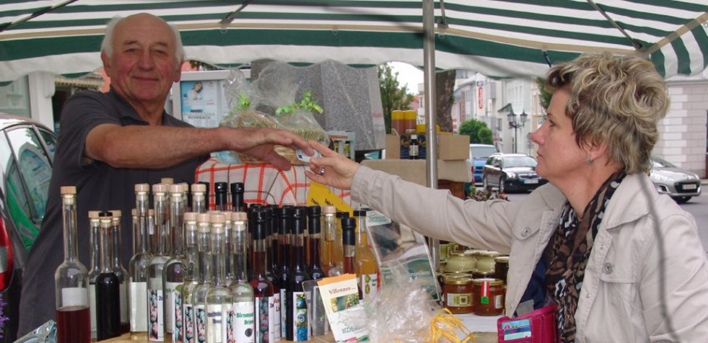
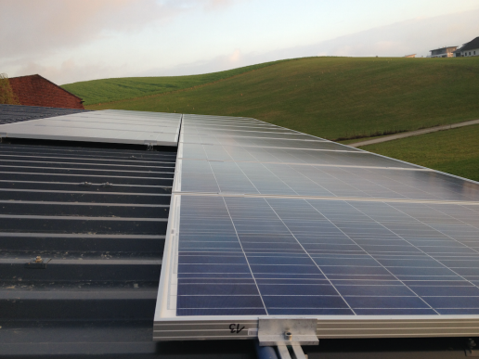


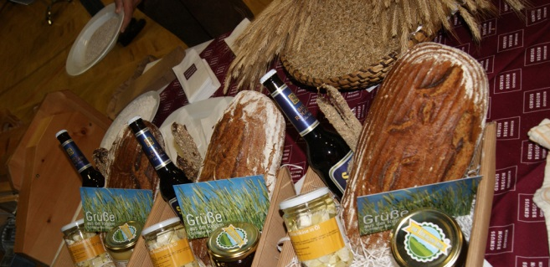
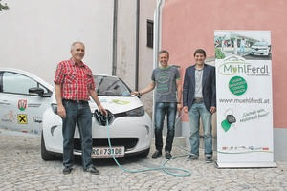

2 Initiatives
Under Our Sky
(documentary on organic farming in Mühlviertel – BR-Rundfunk)
Notes:
orgainic region:
25% of area are maintained on principles of organic farming
2004 first idea to establish initiative „organic region“
Analysis, Concepts, loose cooperation structure formed by LEADER groups
2015 foundation of own association of farms, companies, … - spread knowledge on organic farming, product development, consumer-producer plattforms,...
energy region:
1995 district of Rohrbach first energy concept on regional basis in Austria
2000-2010 many communal heating systems based on wood chips installed (1 of 3 municipalities)
Enterprises working in the are of renewal energy (Ökofen – Pellets boiler, M-Tec - geothermie, Hydro Energy water turbines,…)
2011 decission LEADER region: we want to be a „pilot region for renewable energy – energy autonomous“
2013 – regional energy group founded – to implement crowd funding energy projects
2015 first car sharing project started in Sarleinsbach (15 users share electirc car)
2016 – 1 GWh/year is produced by photovoltaic pannels on public buildings (crowd funding)

Slide 14
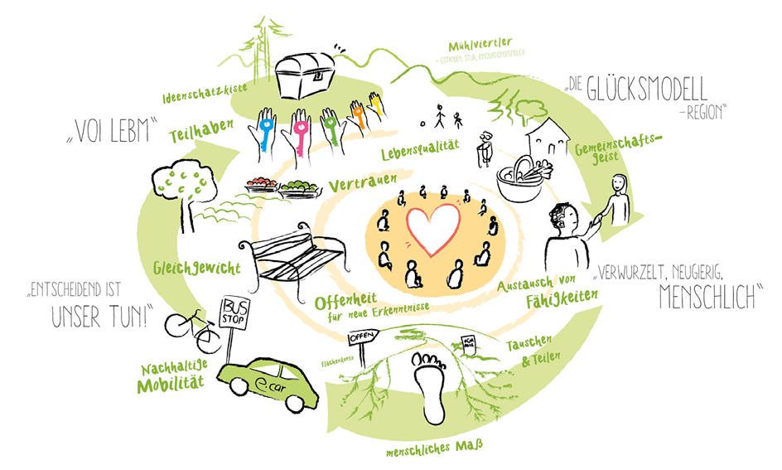
… learnings
Notes:
QUOTES from involved stakeholders:
deep insight of our local action group (consciousness about status-quo and current developments)
co-working atmosphere (science-citizens-politicans) is an important element to bring/keep society healty together
importance of local communities (social skills of people living, being and working in the village/region – interactive neighbourhoods)
usage of energy and environmental awareness are important drivers
community and volunteer work (pass experience on to children/young adults)
space to reflect individual behaviour, consumtion patterns
discover the treasures of Danube-Bohemian Forest region and new life styles
exchange of experience, opinion and good ideas with other people
inter-national communication about own region
„re-thinking“ of own life-style, strive for improvements and implement innovations
the vision 2040 enriched my work in the local women-network, for the first time we got confidence to start a LEADER project called „gardening together“!
I gained lots of motivation from the common meetings to implement something in my region, to initiate with other people projects – this is not often the case after a workshop lasting several hours
I am astonished how nice it is to collaborate in a group

Slide 15
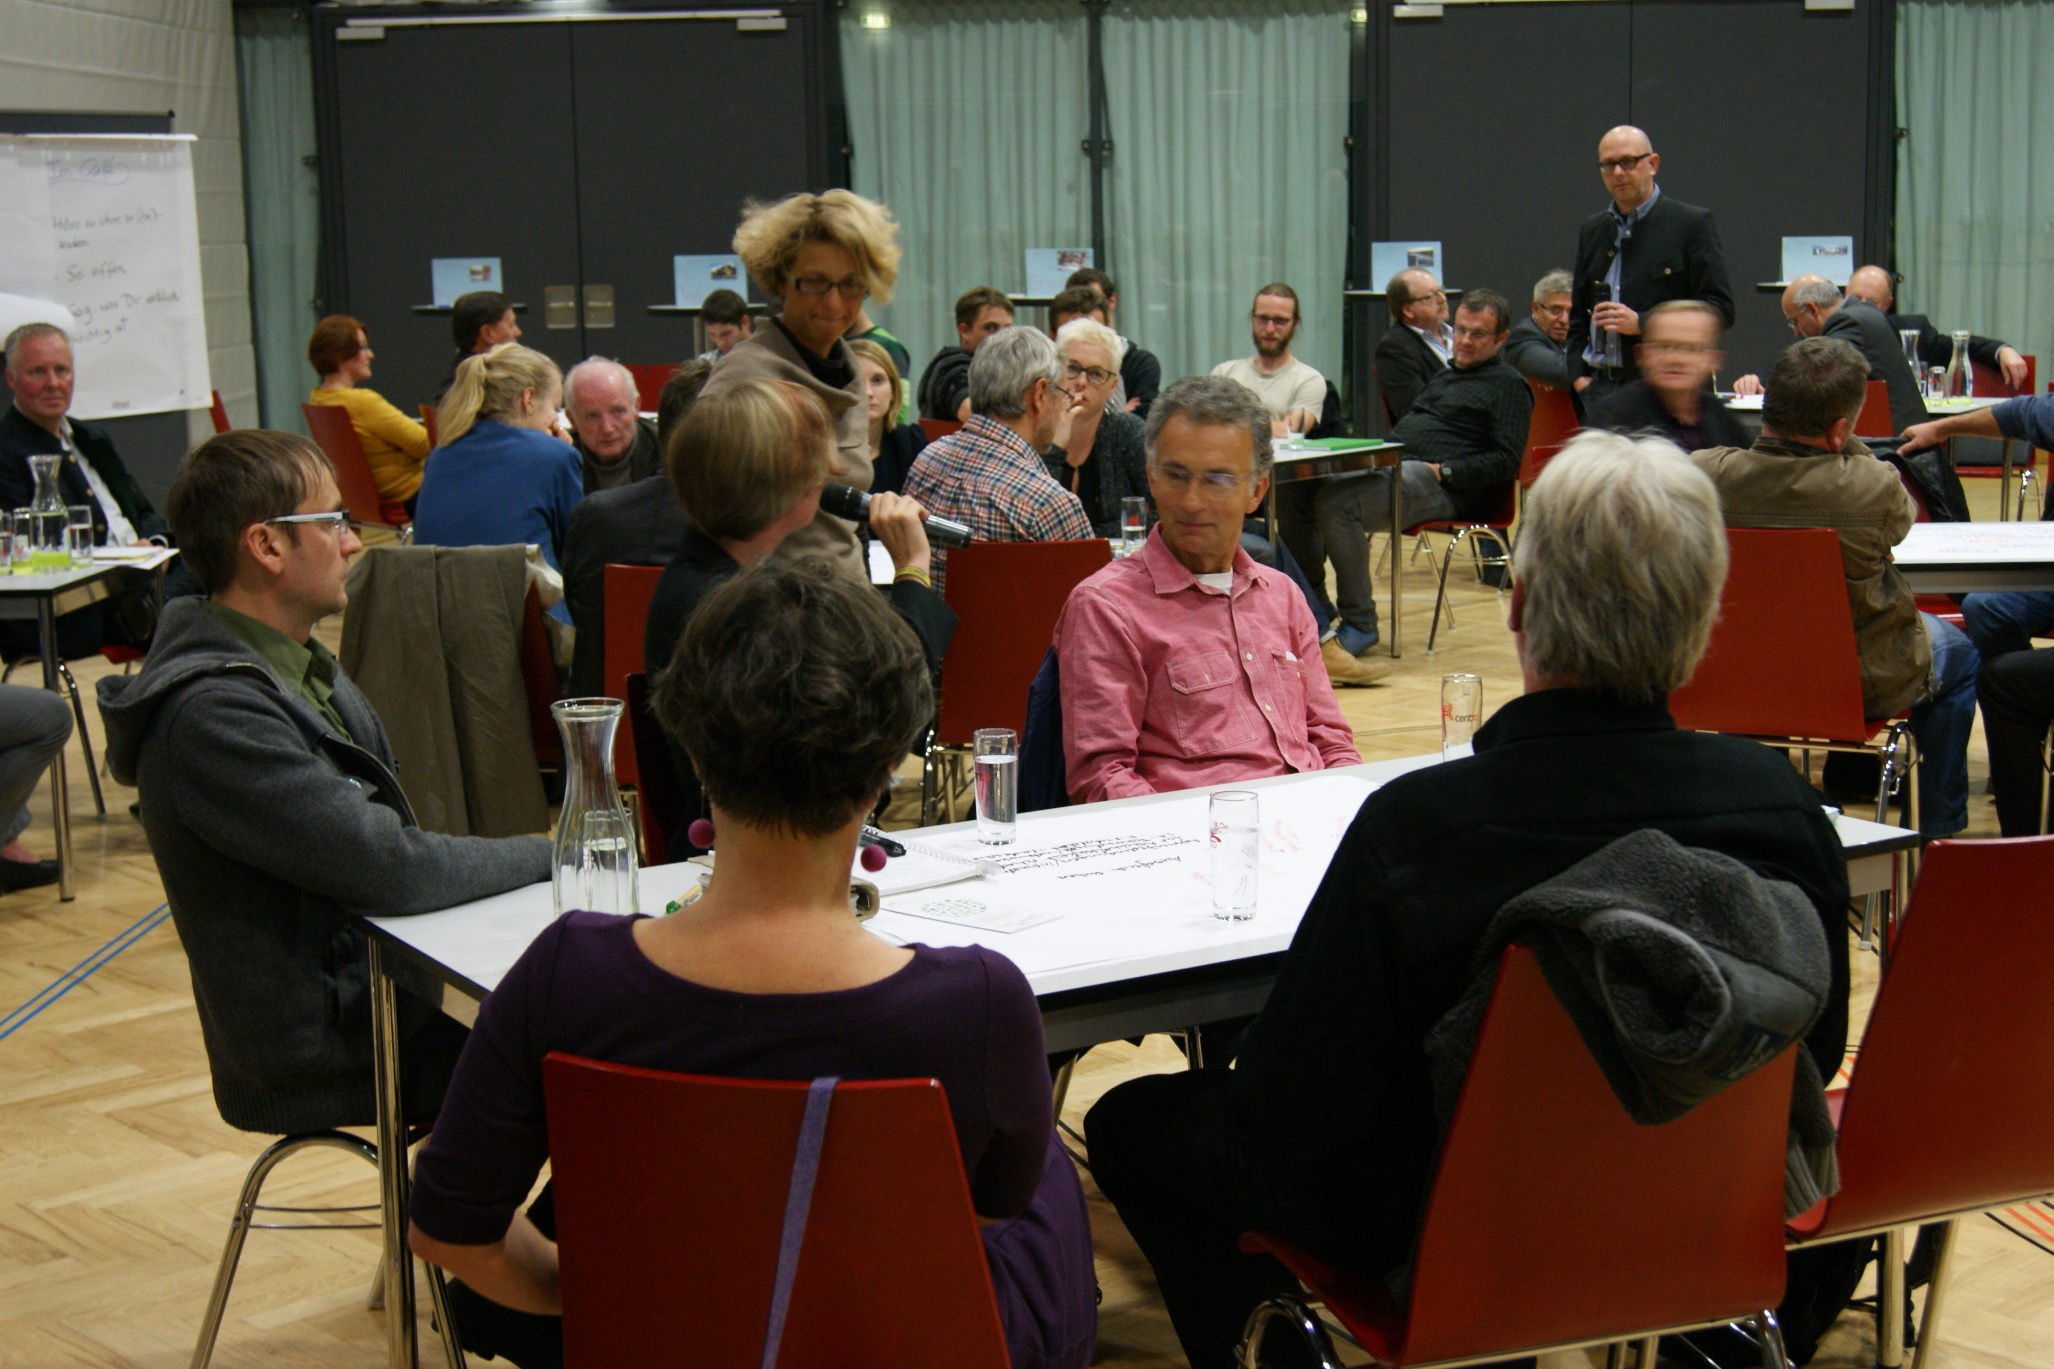
GLAMURS I liked because…
Notes:
focus on individual approach – individual perspective in exchange with:
events, meetings, workshops, interesting encounters,…
traveling to Timisoara and back with a small mini-bus passing by Vienna, heading to Budapest in direction of Banat through beautiful landscape
many students getting aware of our local action group (several master thesis)
INTERACTion of research - civil society – politics
recurrent theme/idea of the project with clear individual steps in the process from the beginning

Slide 16
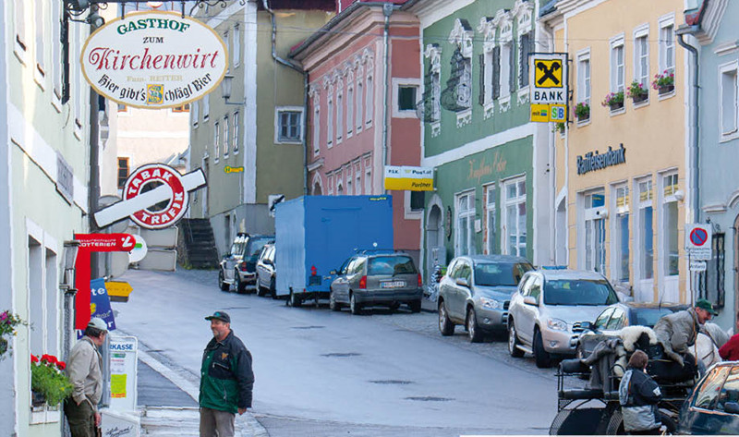
I missed …
Notes:
lack of personell ressources to accompany research activities in case study region (small office of 2,5 staff members)
following activities were necessary for 2,5 years apart from my regular job:
providing data,
passing-on past research results,
investigation of contacts in the region,
organisation of invitation lists/mailing lists,
event locations,
mailings of documentation,
feed-back to reports,
interim results,
publicity&informations work to local and interest groups,
media works, travel organisation
consider lack of personell ressources in case study regions
very high effort on elaboration of survey and activation people to participate – little output
project very much focused on analysis and inventory in case study regions
mainly innerregional/local discussions/meetings
little impulses for regional work from Austrian state/Upperaustrian government

Slide 17
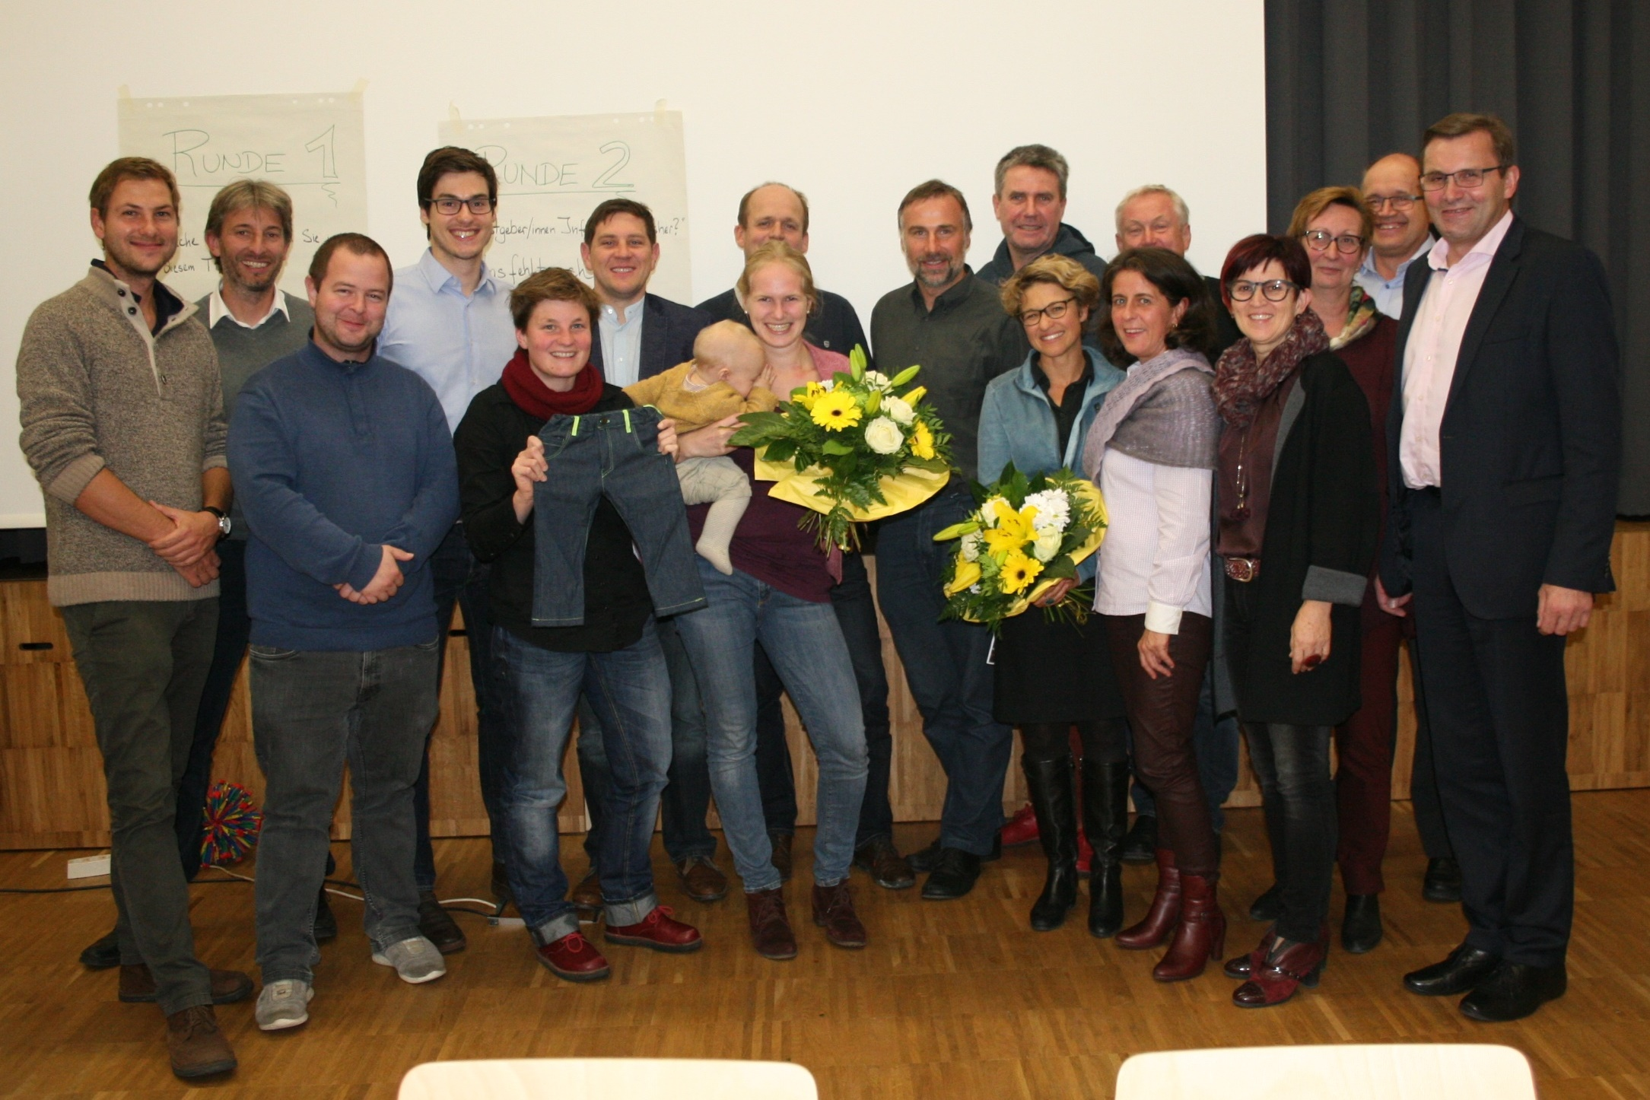

How to use results?
Notes:
we want …
on-going communication of, and dialogue about the extensive results of GLAMURS and our vision for 2040
change needs local contact person to stick on this topic in our region in the next years to come
extend services provided from our office to the region:
linking research results with practical knowledge
process oriented guidanec of the vision 2040
Implementation of short-medium-long term measures related to the eight topics of the vision and/or a selection of topics
… to be a driver for the implementation of the vision 2040
(draft goals of a project fiche for follow-up activities within the LEADER approach of European Union)

Slide 18
My questions…
research | government
How could capitalization of analysis/inventories look like? | What could be pathways to strengthen local approaches in Europe?
What are„earth-fitting“ lifestyles in the 21st century?
Notes:
Research
What is needed to activate the knowledge gained?
How could be profits generated?
Government
consider short term, medium term, long term needs on local level?
Differentiate:
observers
partnership
expertise
pilot/pioniers
All together:
What are needs for the next 20 years of our society?
How will time-usage look like (mobility, work, leisure, food, education, community, on-line/off-line,…) in Europe?
What should grow? What should be reduced?

Slide 19
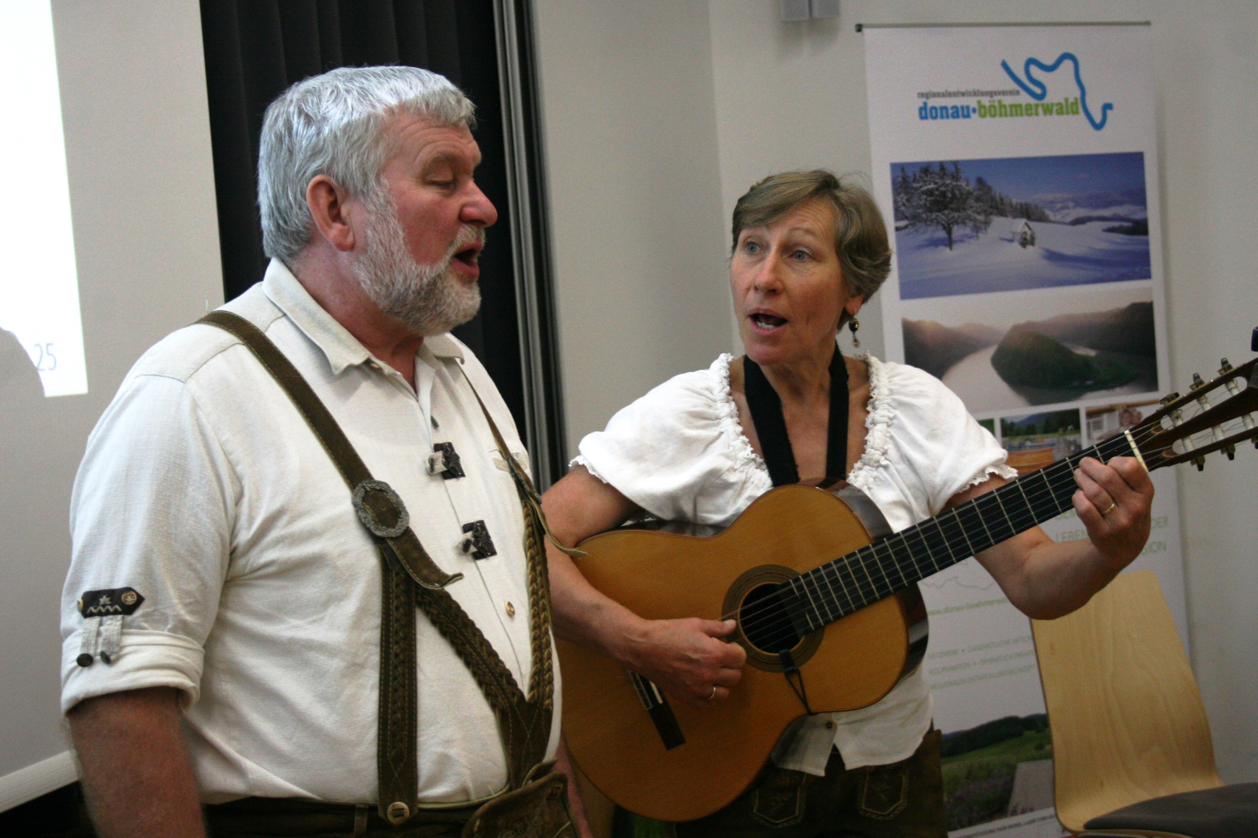
Questions - What are your questions?
Notes:
If you think about your future:
- What would you like to ask about life-style changes?
- What is your motivation to do so?
- What inspires you?
- What do you need for life-style change?

Slide 20
Transforming work: Discussion
Facilitator: Adina Dumitru, University of A Coruña
Harvester: Ellen Matthies, University of Magdeburg

Slide 21
Discussion questions
What is particularly interesting and useful from both the results of the GLAMURS project and the Austrian sustainable initiative on how work and leisure should be transformed to achieve transition to sustainable lifestyles?
What transformations could further be explored/experimented with? How could they be supported?
What should the role of different stakeholders be (governments, initiatives, researchers, businesses etc. (name at least one important role for each) in this process?

Slide 22
Transforming work: Harvesting
Facilitator: Adina Dumitru, University of A Coruña
Harvester: Ellen Matthies, University of Magdeburg

